Slide 1
Homochiral ideas
Marianne Imperor-Clerc
October 2025

Slide 2
Objectives
Keep the same chirality when building the whole tiling by inflation
Use only rotations and translations operations: no mirrors !
(avoid usage of the four key-points in the original inflation rule)
Keep the monotile shape: Tile(a,b)+Tile(b,a)
Use cluster level (full cluster instead of gamma and omega ones ?)
Make full use of the mapping on a triangular lattice
Make full use of the ODD and EVEN orientations

Slide 3
Homochiral python code on github
Under construction !
https://github.com/marimperorclerc/homochiral
python code for drawing clusters with Tile(a,b) in svg graphics.
References
Code is based on the drawsvg package:
https://pypi.org/project/drawsvg/
And the python code with alternate chirality for inflation for spectre tiling:
https://github.com/shrx/spectre/blob/master/spectre.py

Slide 4
Recent work
Decomposition using one full cluster with six ODD orientations
-> find some ‘simple’ relationships between rotations and translations
Identify regular triangles
Link with the trifle+bow-tie decomposition
Tile(a,b) + Tile(b,a) for ODD and EVEN orienations

Slide 5
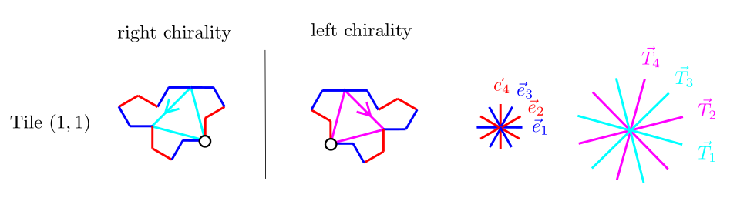
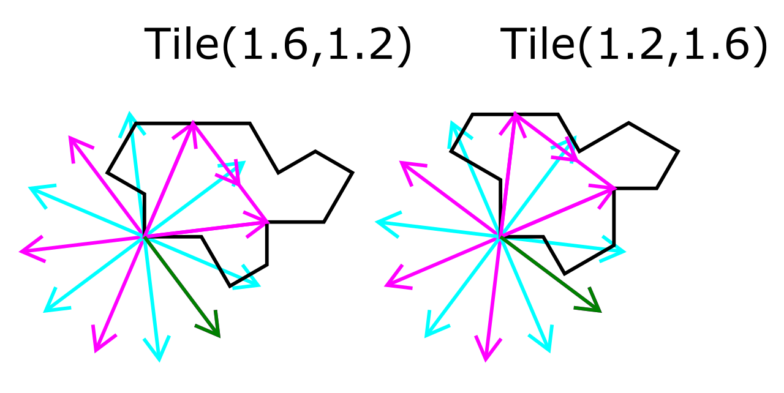
New reference triangle in Tile(a,b)
Robust for any T(a,b) tile ☺
a=1.6
b=1.2

Slide 6
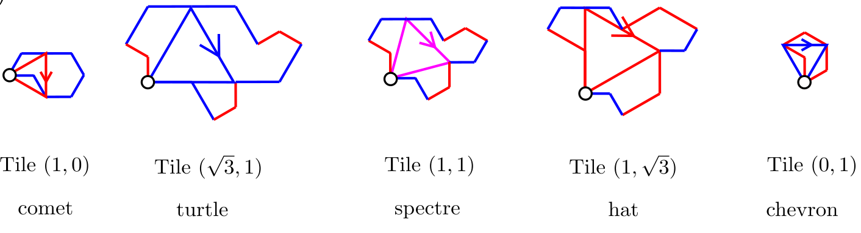
New reference triangle in Tile(a,b)
Angle between arrow and x directions:
Pi/2
Pi/3
Pi/4
Pi/6
0
sqrt(3)
2*sqrt(3)
sqrt(6)
2*sqrt(3)
sqrt(3)
Edge length of the regular triangle = sqrt(3)*sqrt(a^2+b^2)
6

Slide 7
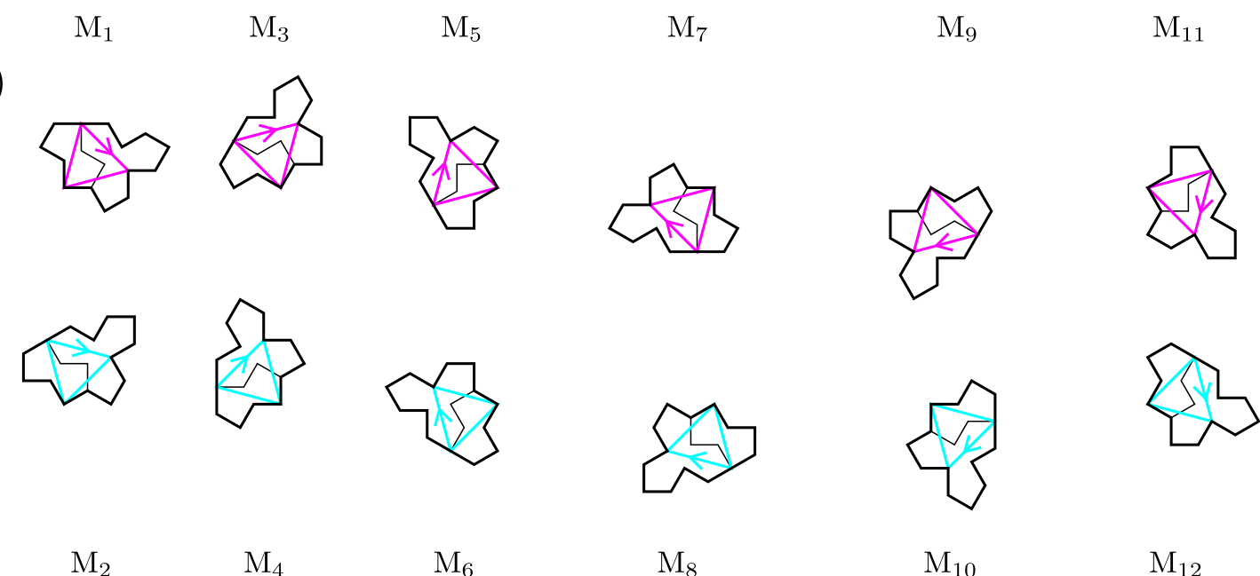
ODD and EVEN orientations for Tile(1,1)

Slide 8
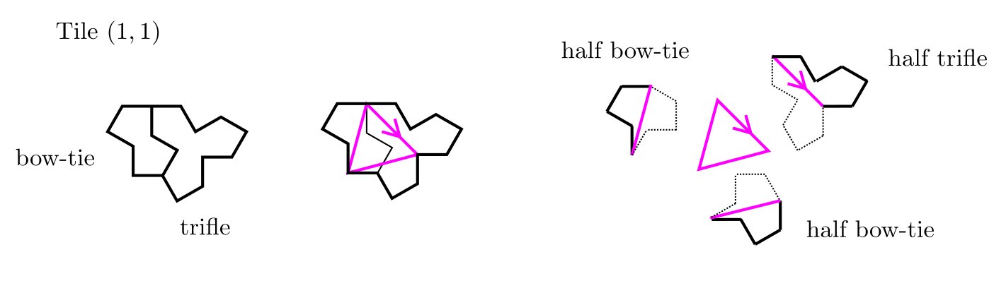
Link with trifle and bow-tie in Tile(1,1)

Slide 9
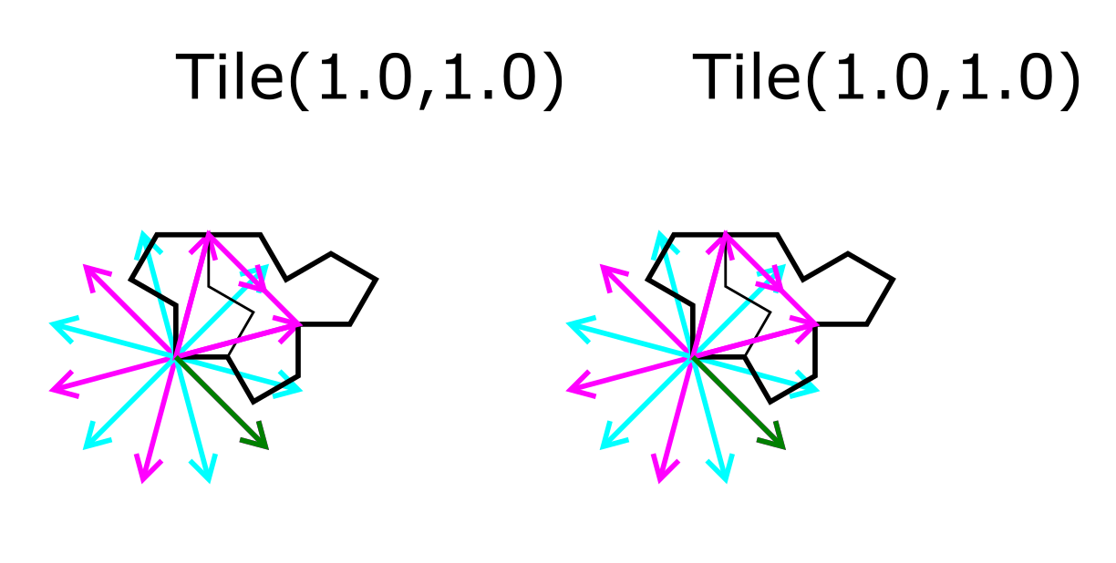
Tile(1,1) : spectre tile

Slide 10
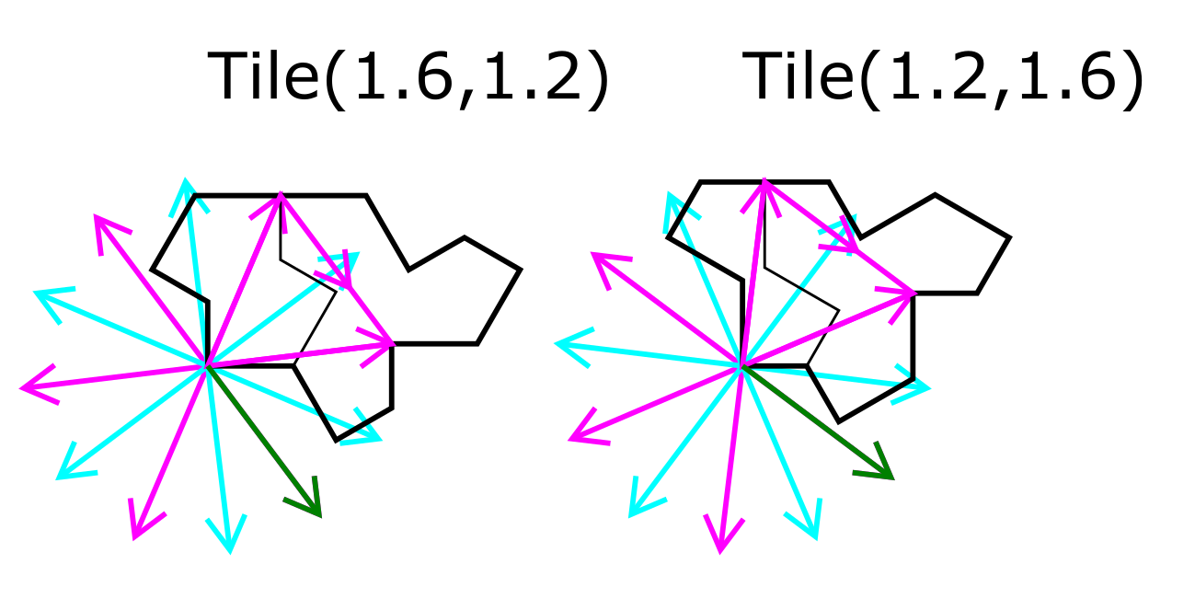
Tile(a,b) and Tile(b,a)
Thin and fat bow-ties
Trifle gives left and right chiral shapes
The 12 base vectors deduce from a vertical mirror reflection

Slide 11
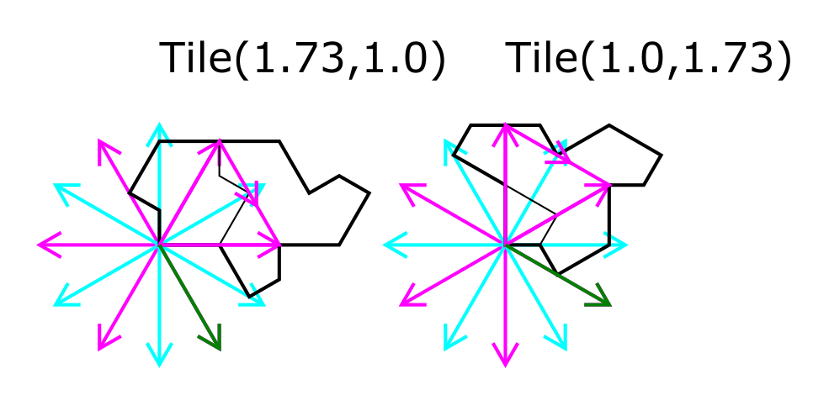
Tile(a,b) and Tile(b,a) for turtle and hat
Thick and fat bow-ties
Trifle gives left and right chiral shapes
The 12 base vectors deduce from a vertical mirror reflection

Slide 12
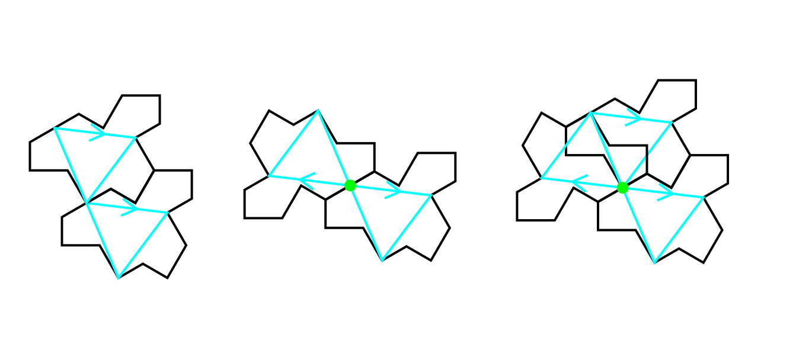
Duplicated versus inverted for any Tile(a,b)
a=1.6
b=1.2
Duplicated tile versus inverted tile

Slide 13
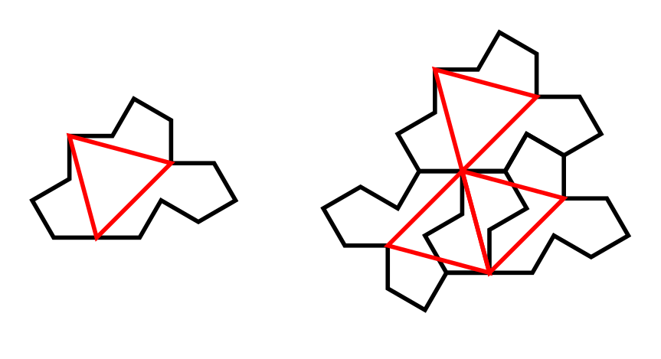
Duplicated versus inverted for right Tile(1,1)
Half-bow
Half-bow
Half-trifle
2 other shapes are left:
-> 2 half-bows
-> 1 half-trifle
Duplicated tile versus inverted tile

Slide 14
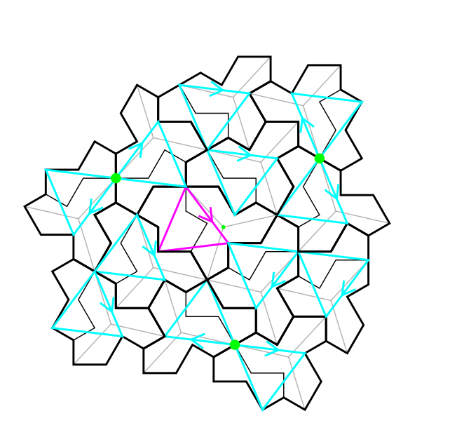
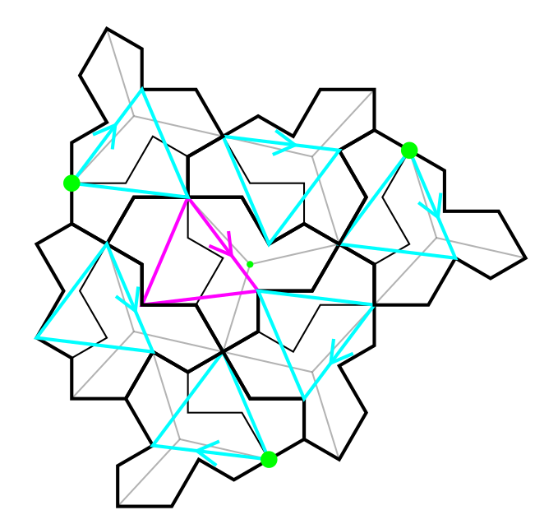
Cluster and full cluster
a=1.6
b=1.2
Green points always form a regular triangle ☺

Slide 15
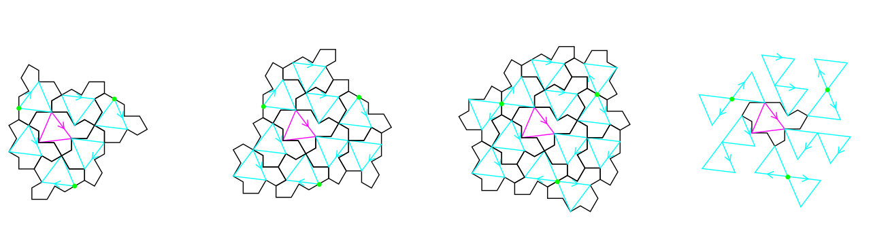
Cluster and full cluster
a=1.6
b=1.2
C cluster
(corona around a ODD tile)
The three duplicated tiles are all in the tiling
Three more possible tiles using inversion around the green points

Slide 16
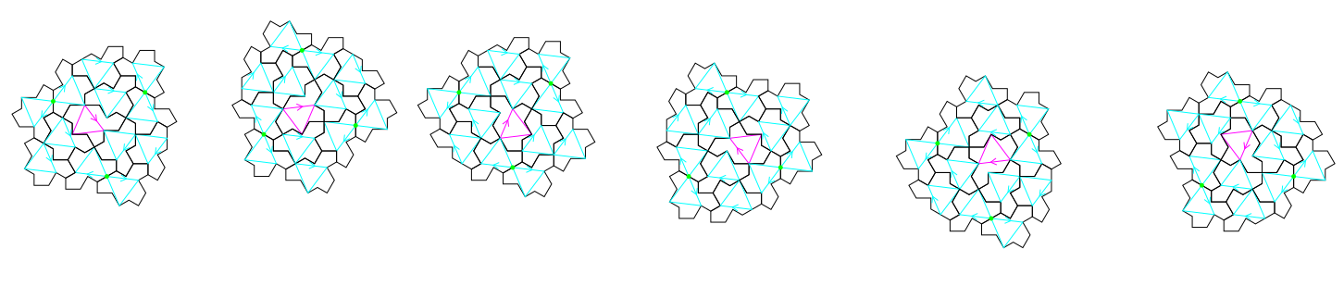
full cluster with its six rotations: n(2pi/6)
a=1.6
b=1.2
C1
C2
C3
C4
C5
C6
TO DO: code assembly rules using translations along triangle edges !
Link between translations and relative ODD orientations ???
-> combinatory properties

Slide 17
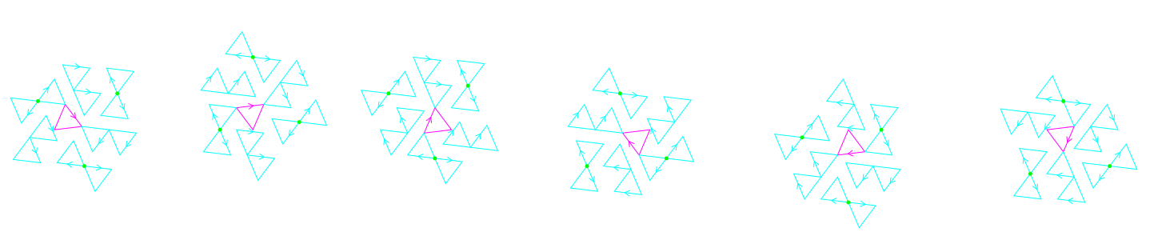
full cluster with its six rotations: n(2pi/6)
a=1.6
b=1.2
C1
C2
C3
C4
C5
C6
TO DO: code assembly rules using translations along triangle edges !
Link between translations and relative ODD orientations ???
-> combinatory properties

Slide 18
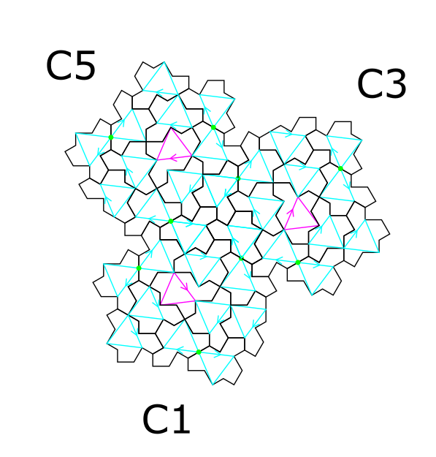
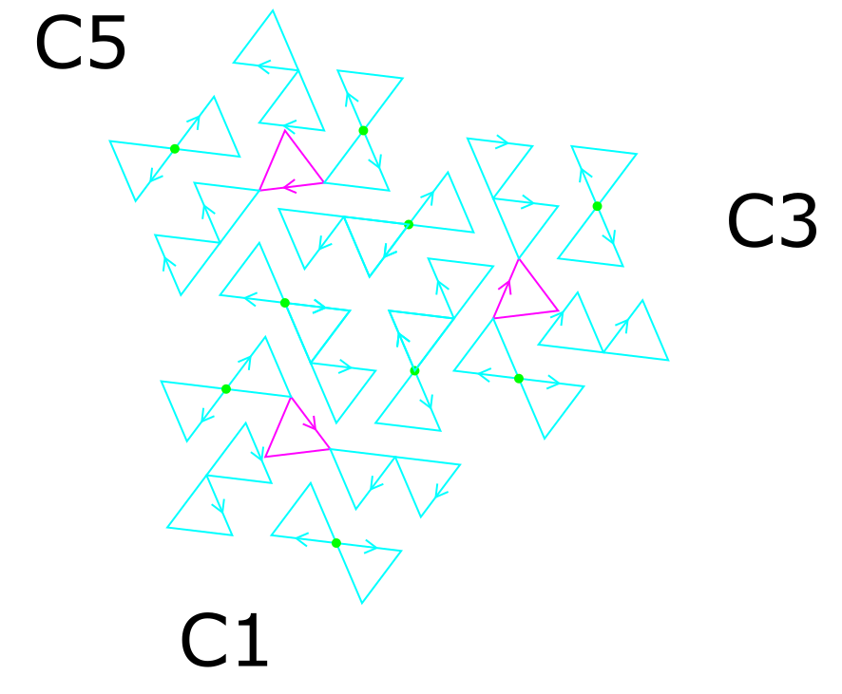
Some combination of three clusters

Slide 19
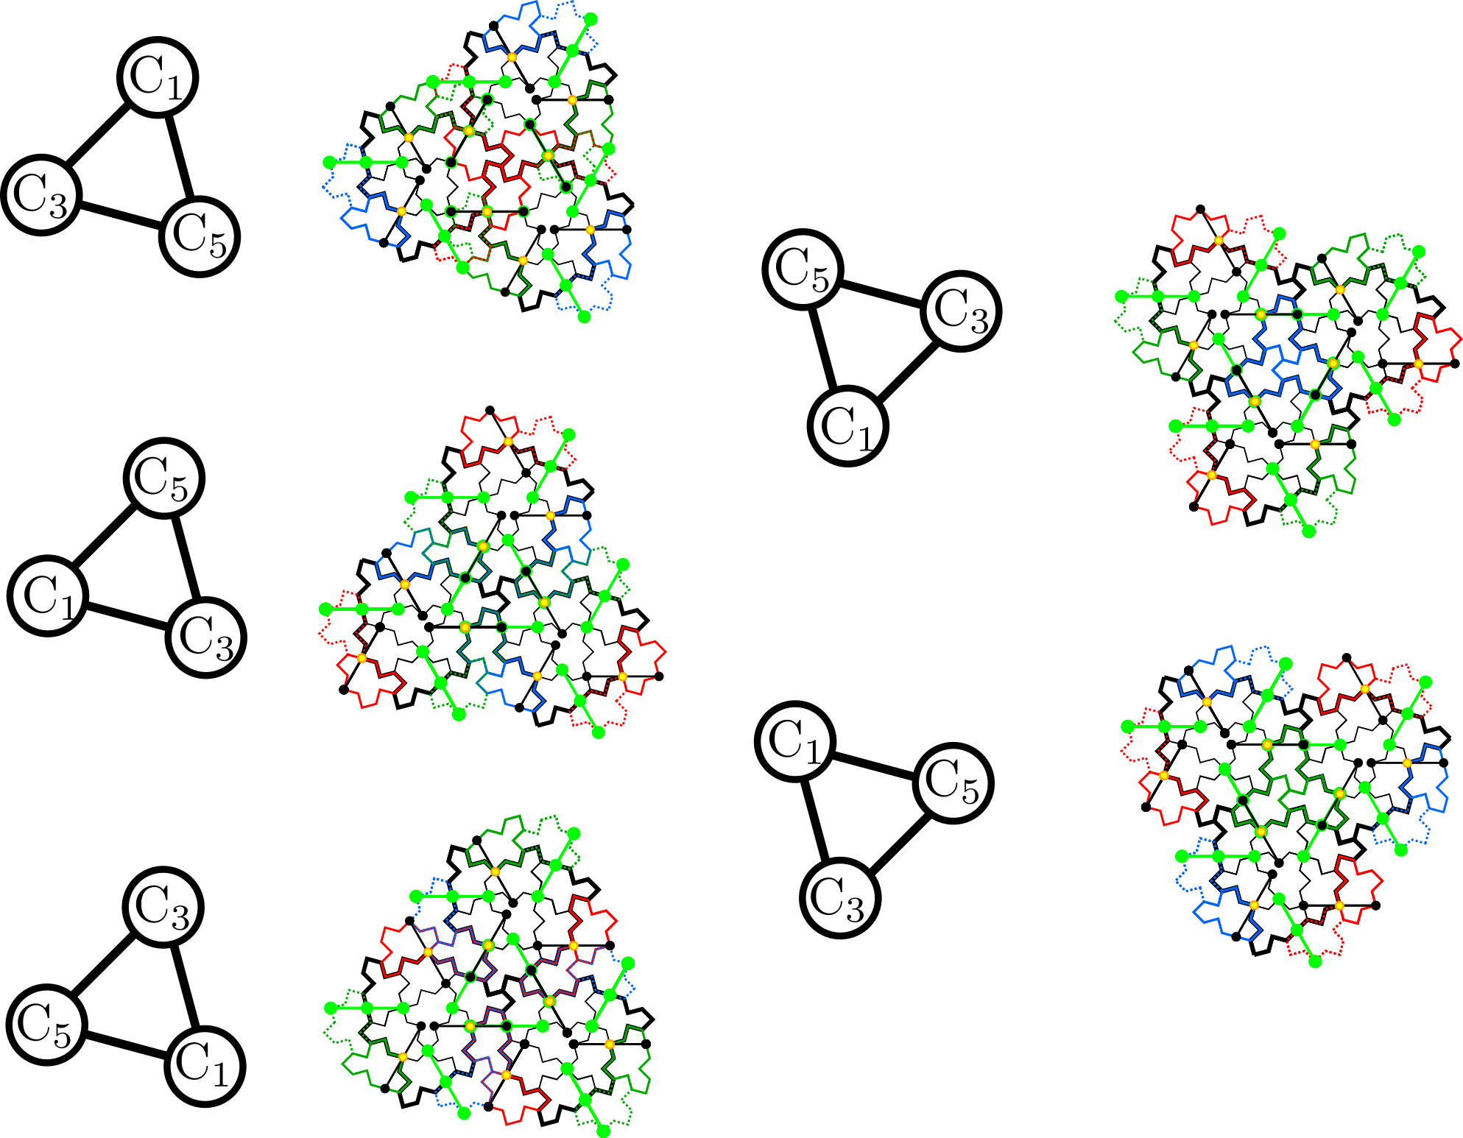
C1, C3 ,C5 triangle : 5 possible combinations
Possible seed for homochiral inflation ???

Slide 20
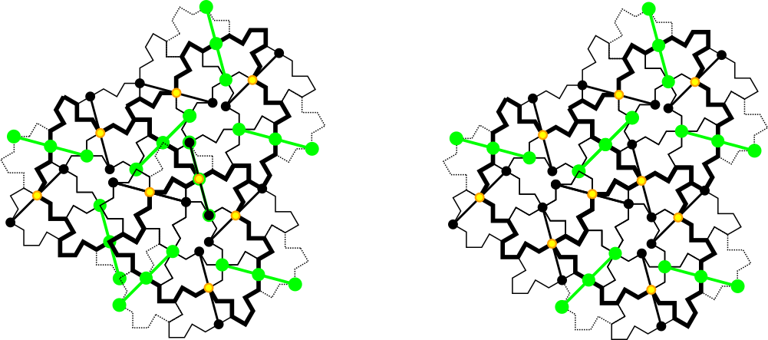
Defect healing by keeping the black line when superposition with a green one
Starting point for worms ☺
After removing two inverted tiles

Slide 21
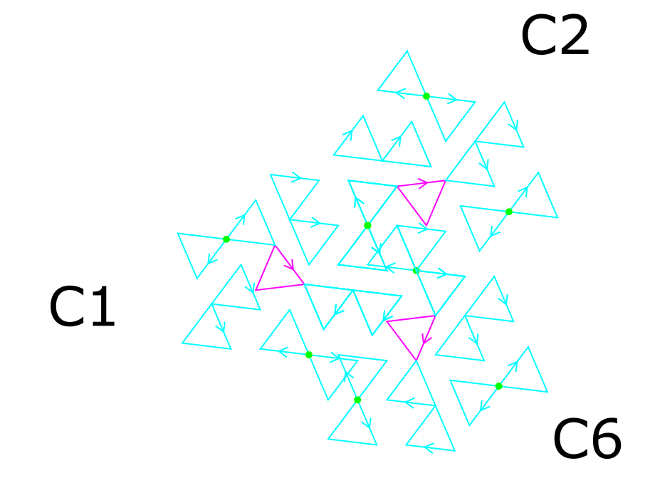
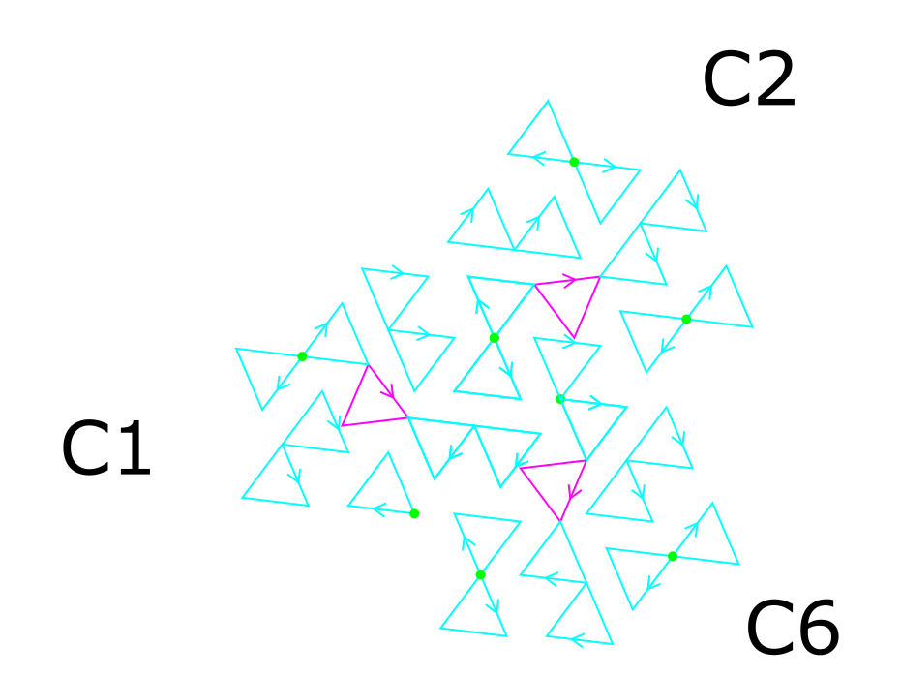
Defect healing
Starting point for worms ☺
After removing two inverted tiles

Slide 22
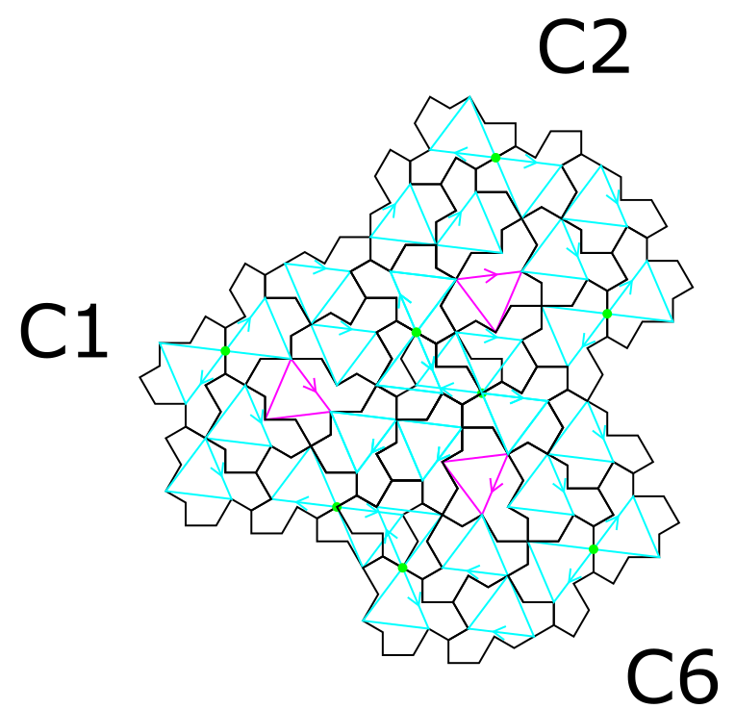
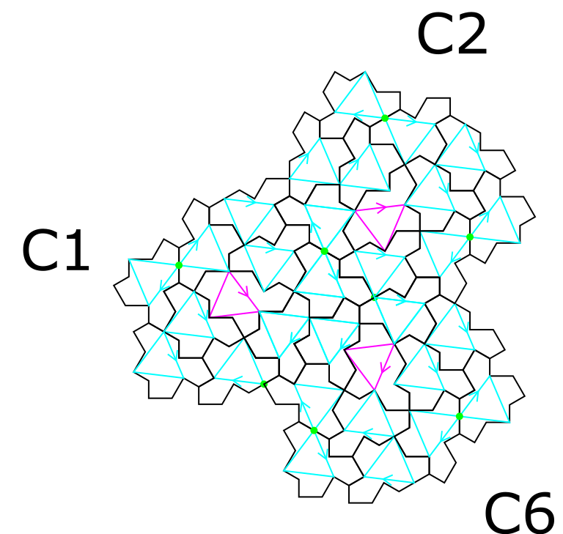
Defect healing
Starting point for worms ☺
After removing two inverted tiles

Slide 23
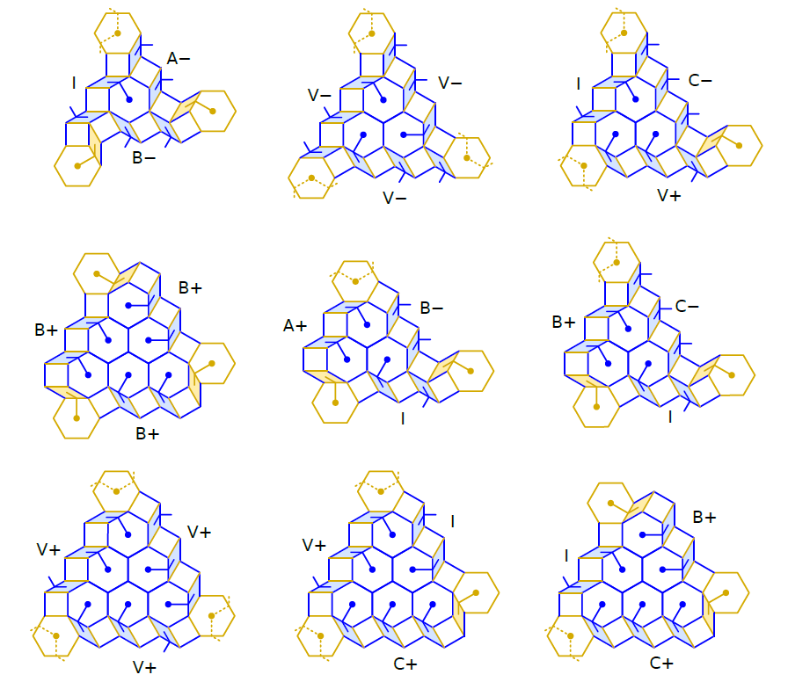
Types of hexagonal clusters
Combinatorial properties
Chéritat, A., (2024). Observations on the hex clusters of the spectre tilings. https://arxiv.org/abs/2407.05359

Slide 24
Find equivalence with the hexagonal clusters ?
?
Chéritat, A., (2024). Observations on the hex clusters of the spectre tilings. https://arxiv.org/abs/2407.05359

Slide 25
Further ideas …
Use cluster level
For rotation part: CODE the sequence of the six rotations in the C cluster to be repeated at larger length scales
For translation part: use the duplicated tiles along the reference triangles and the inverted tiles around the three green points
Hypothesis: rule is that when two duplicated tiles superimposed with two inverted tiles at a green point, one inverted tile is omitted
Use the green points to assemble the clusters ???

Slide 26
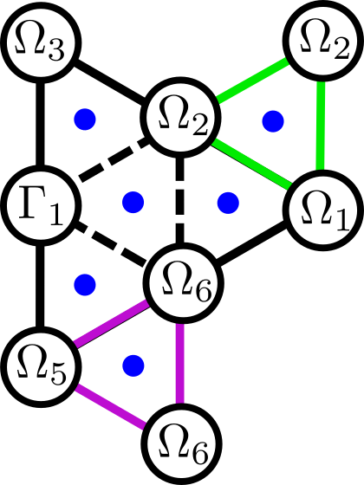
Add the full cluster at this level ???
C6
C1
C4
C3

Slide 27
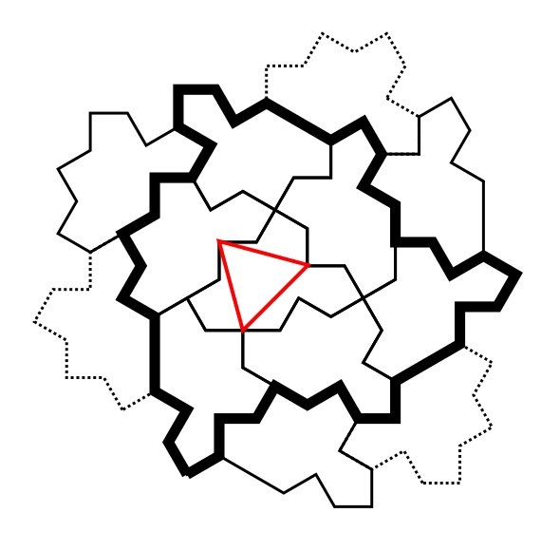
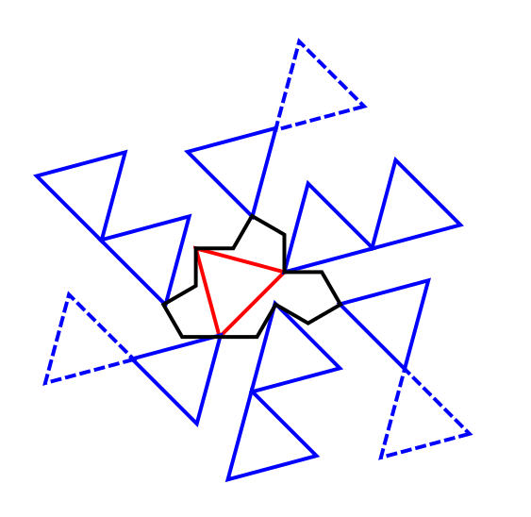
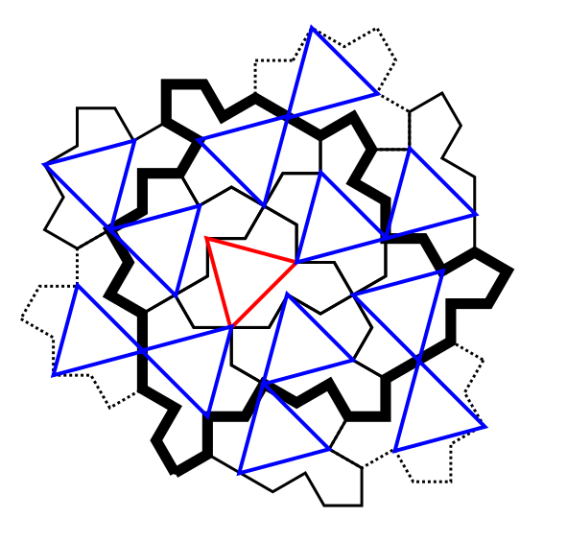
Triangles inside a full cluster

Slide 28
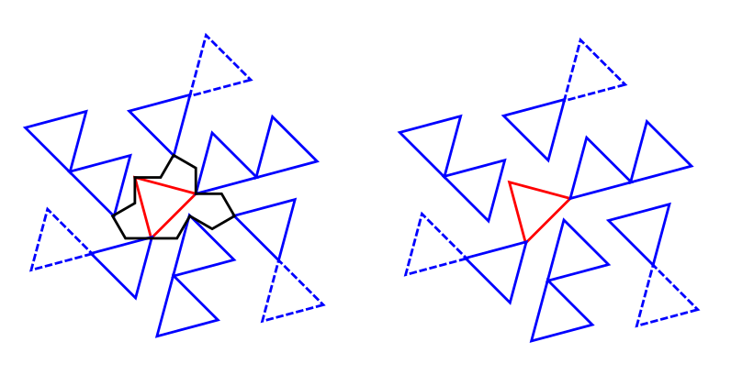
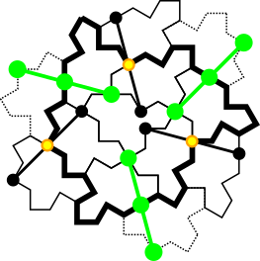
Identification of junction lines

Slide 29
Sequence of rotations
−π/6
=π/6+5π/3
π/6+2π/3
π/6
π/6+π/3
π/6
π/6+π/3
0
π/6
π/6+π/3
−π/2
−π/6
=π/6+5π/3
=π/6+4π/3
−π/6
π/6+π
=π/6+5π/3

Slide 30
Sequence of rotations
5π/3
2π/3
0
π/3
π/3
0
−π/6
0
π/3
5π/3
4π/3
3π/3
5π/3

Slide 31
Sequence of rotations
5
2
0
1
1
π/3=2π/6
factorization
0
−1/2
0
1
5
4
3
5

Slide 32
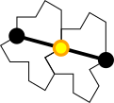
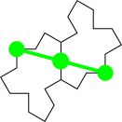
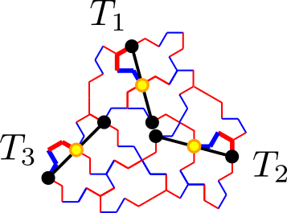
Junction lines between full clusters
translation
inversion
Three black points and three green points on the odd monotile in the middle.
They are located always at the same positions.
Three even monotiles outside the C cluster in dashed lines obtained by inversion.

Slide 33
Junction lines
translation
inversion
Black junction lines == translation == always present
when two clusters are assembled, some green lines may be superimposed on black ones !!!
-> black one is the good one
-> translation and not inversion

Slide 34
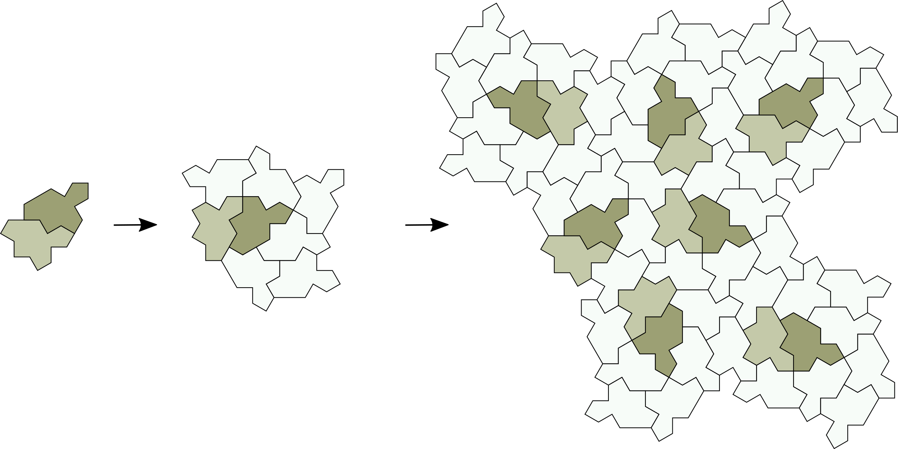
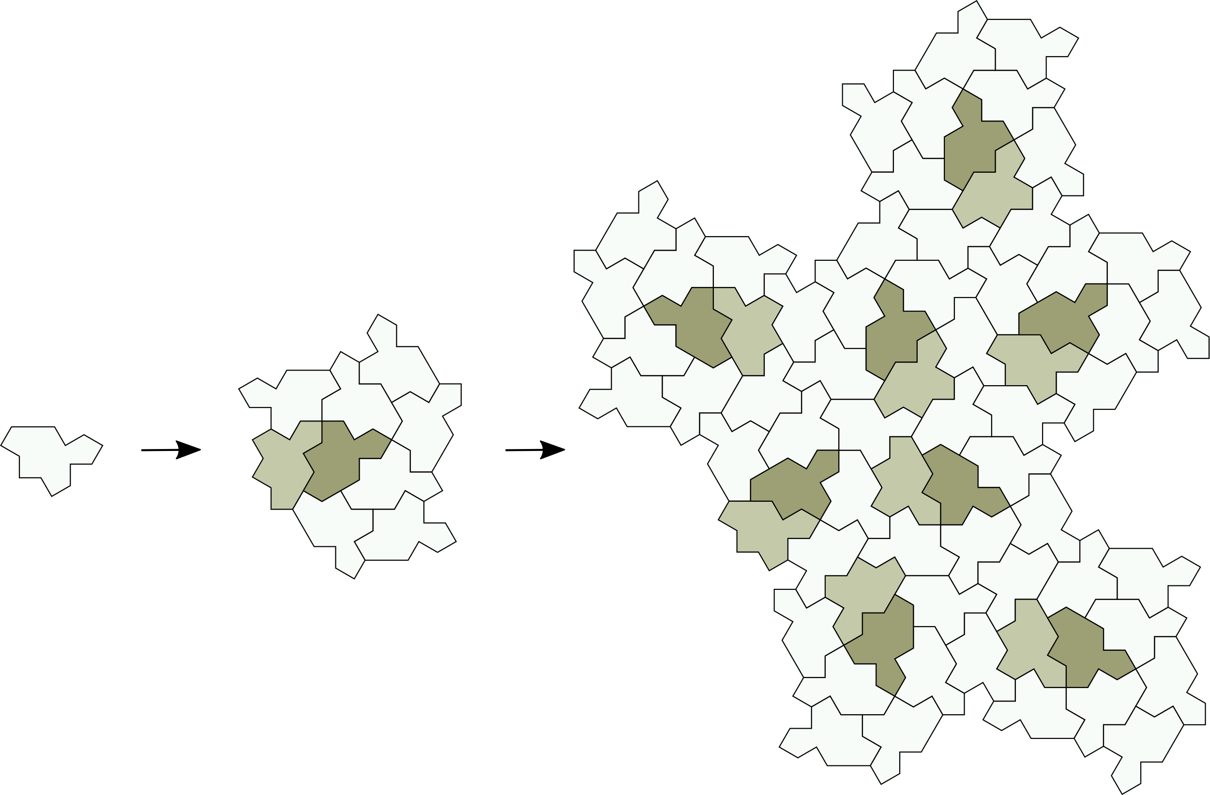
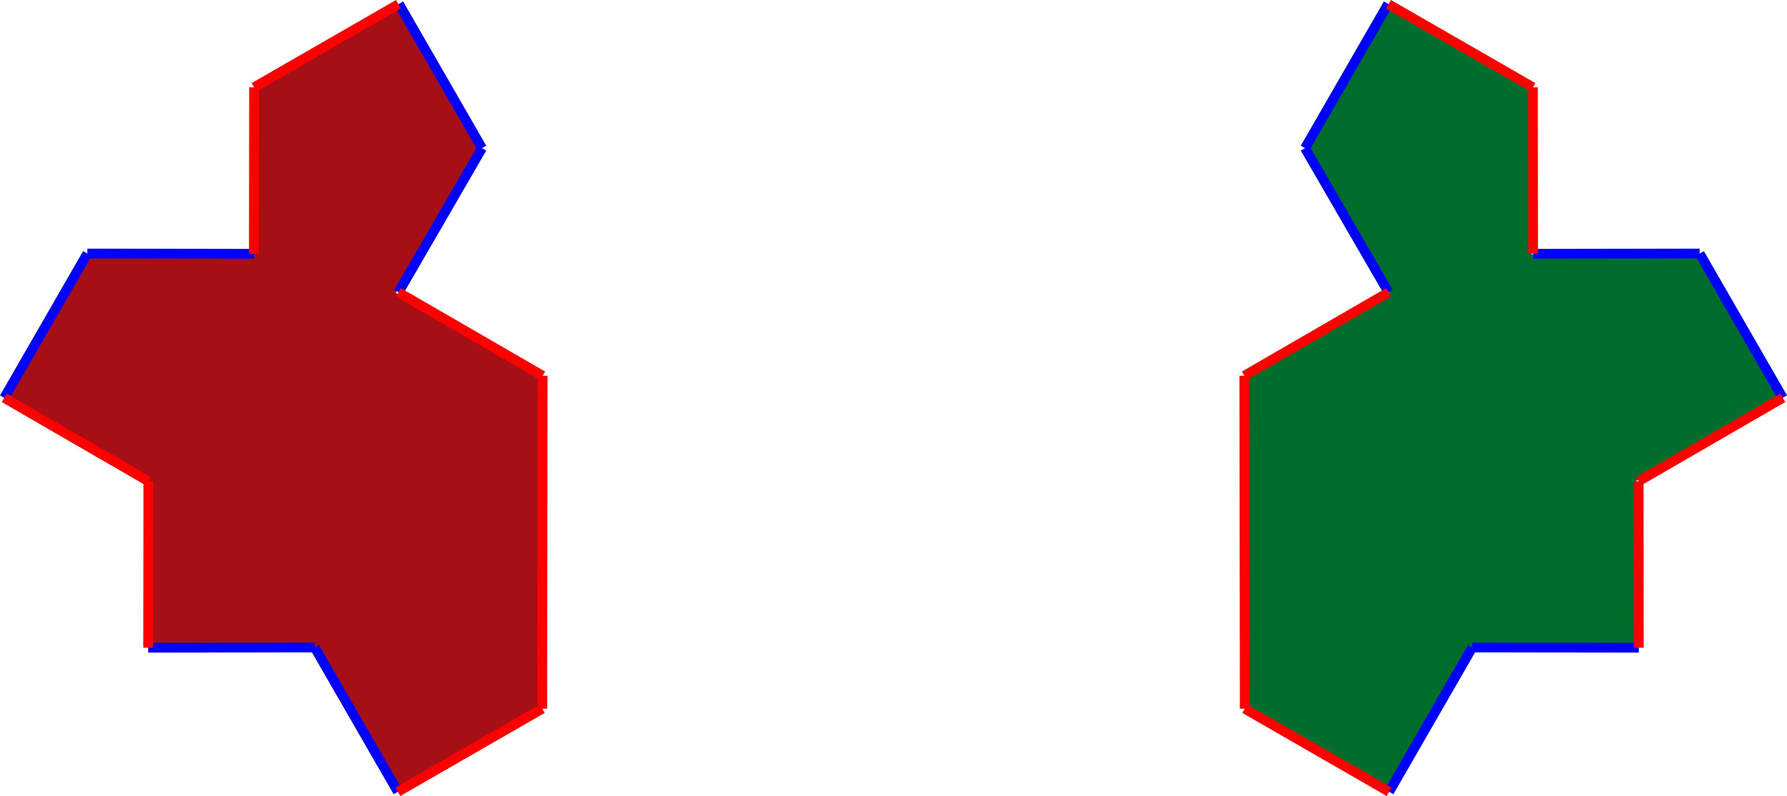
Inflation with alternate chirality of Tile(1,1) at each step
☹
https://cs.uwaterloo.ca/~csk/spectre/app.html
-> Need for homochiral inflation to get the orientation distribution at each inflation step

Slide 35
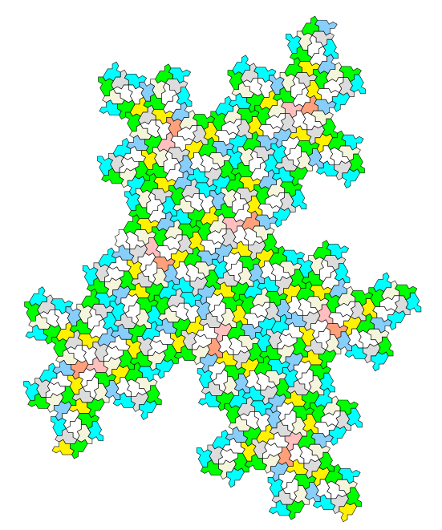
Python script to generate the tiling
Drawsvg python library
https://pypi.org/project/drawsvg/
https://github.com/shrx/spectre/blob/master/spectre.py

Slide 36
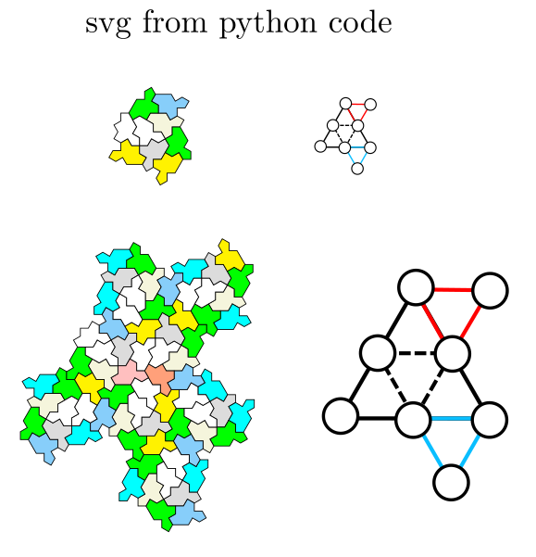
Python script: step 1

Slide 37
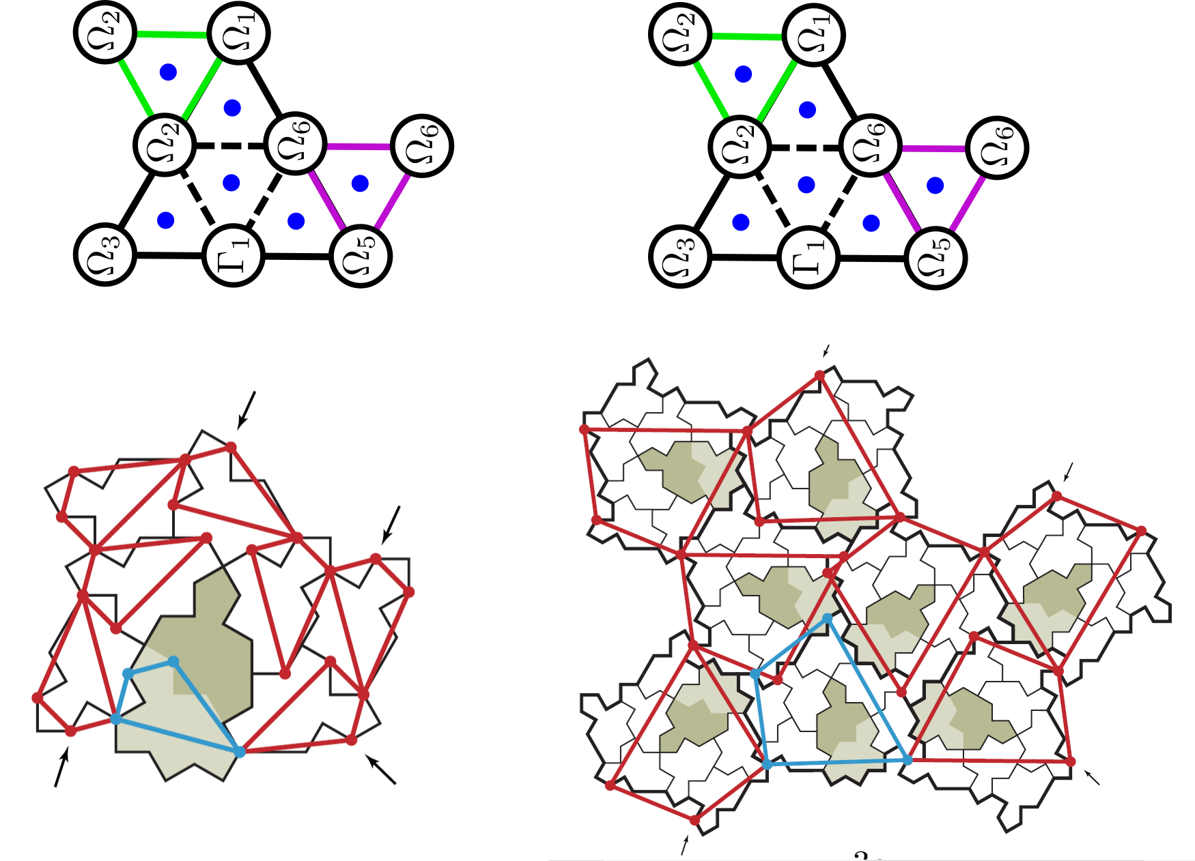
Fig A.1 (annexe)

Slide 38
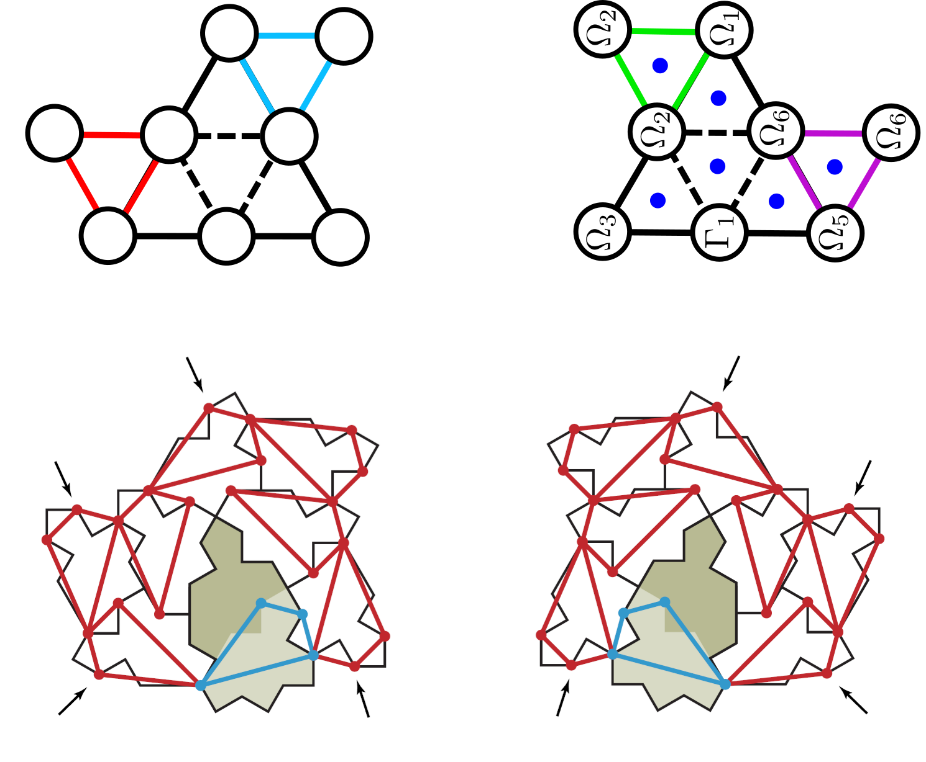
Comparision with Fig A.1 (annexe)

Slide 39
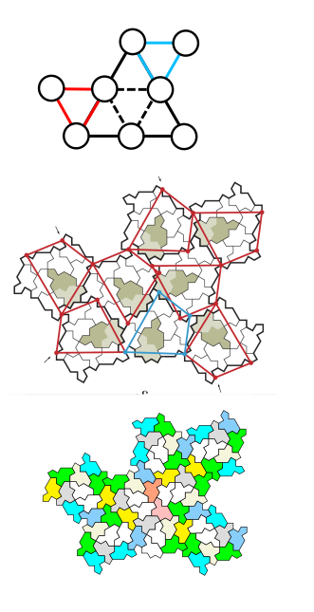
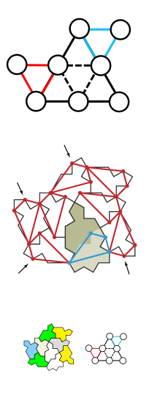
Comparision with Fig A.1 (annexe)

Slide 40
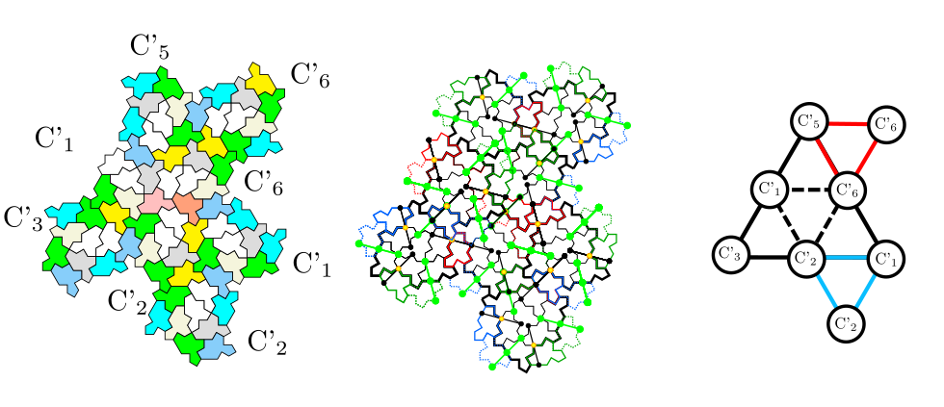
Sequence of eight clusters

Slide 41
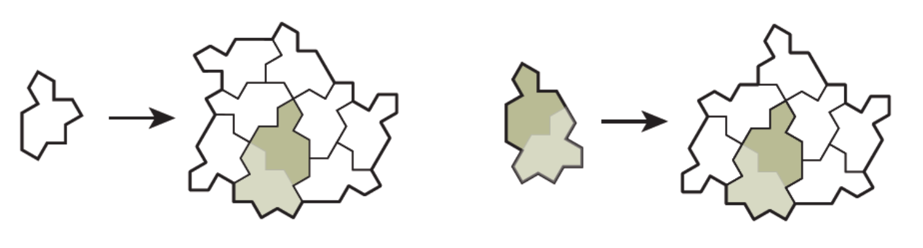
Substitution rule

Slide 42
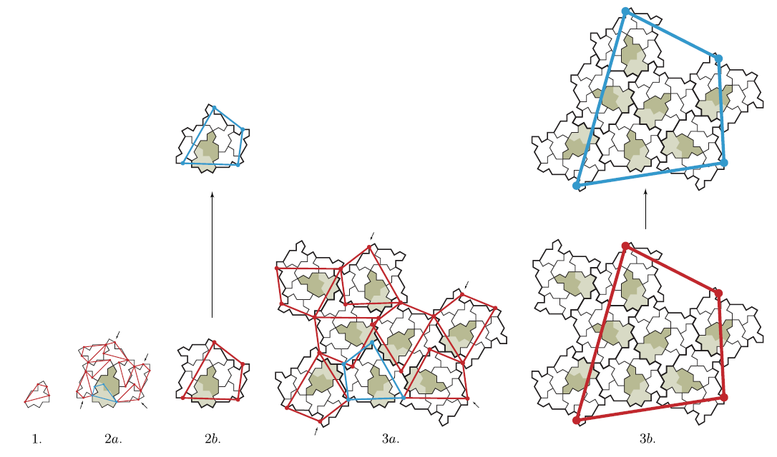
Key points

